Slide 1
Engaging Students in the Past in Order to Prepare Citizens of the Future
Dr. Tammara Purdin, Florida Council for History Education
Carol LaVallee, M.Ed, Library of Congress Ambassador

Slide 2
Library of Congress Primary Sources
Teachers have a duty to ensure their students understand how important civil liberties are to help our democratic republic stay in tack.
http://www.loc.gov

Slide 3
Florida Standards
Benchmark# | Description
LAFS.1112.RI.3.8 | Delineate and evaluate the reasoning in seminal U.S. texts, including the application of constitutional principles and use of legal reasoning (e.g., in U.S. Supreme Court majority opinions and dissents) and the premises, purposes, and arguments in works of public advocacy (e.g., The Federalist, presidential addresses).
LAFS.1112.RI.3.9 | Analyze seventeenth-, eighteenth-, and nineteenth-century foundational U.S. documents of historical and literary significance (including The Declaration of Independence, the Preamble to the Constitution, the Bill of Rights, and Lincoln’s Second Inaugural Address) for their themes, purposes, and rhetorical features.
LAFS.1112.W.3.9 | Draw evidence from literary or informational texts to support analysis, reflection, and research.
SS.2.C.3.1 | Identify the Constitution as the document which establishes the structure, function, powers, and limits of American government.
SS.3.C.1.3 | Explain how government was established through a written Constitution.
SS.5.A.5.10 | Examine the significance of the Constitution including its key political concepts, origins of those concepts, and their role in American democracy.
SS.5.C.1.2 | Define a constitution, and discuss its purposes.
SS.7.C.1.5 | Identify how the weaknesses of the Articles of Confederation led to the writing of the Constitution.
SS.7.C.2.5 | Distinguish how the Constitution safeguards and limits individual rights.
SS.8.A.3.11 | Analyze support and opposition (Federalists, Federalist Papers, AntiFederalists, Bill of Rights) to ratification of the U.S. Constitution.
SS.912.C.1.1 | Evaluate, take, and defend positions on the founding ideals and principles in American Constitutional government.
SS.912.C.3.1 | Examine the constitutional principles of representative government, limited government, consent of the governed, rule of law, and individual rights.
SS.912.C.3.11 | Contrast how the Constitution safeguards and limits individual rights.
SS.912.C.3.7 | Describe the role of judicial review in American constitutional government.
SS.912.W.2.18 | Describe developments in medieval English legal and constitutional history and their importance to the rise of modern democratic institutions and procedures.

Slide 4
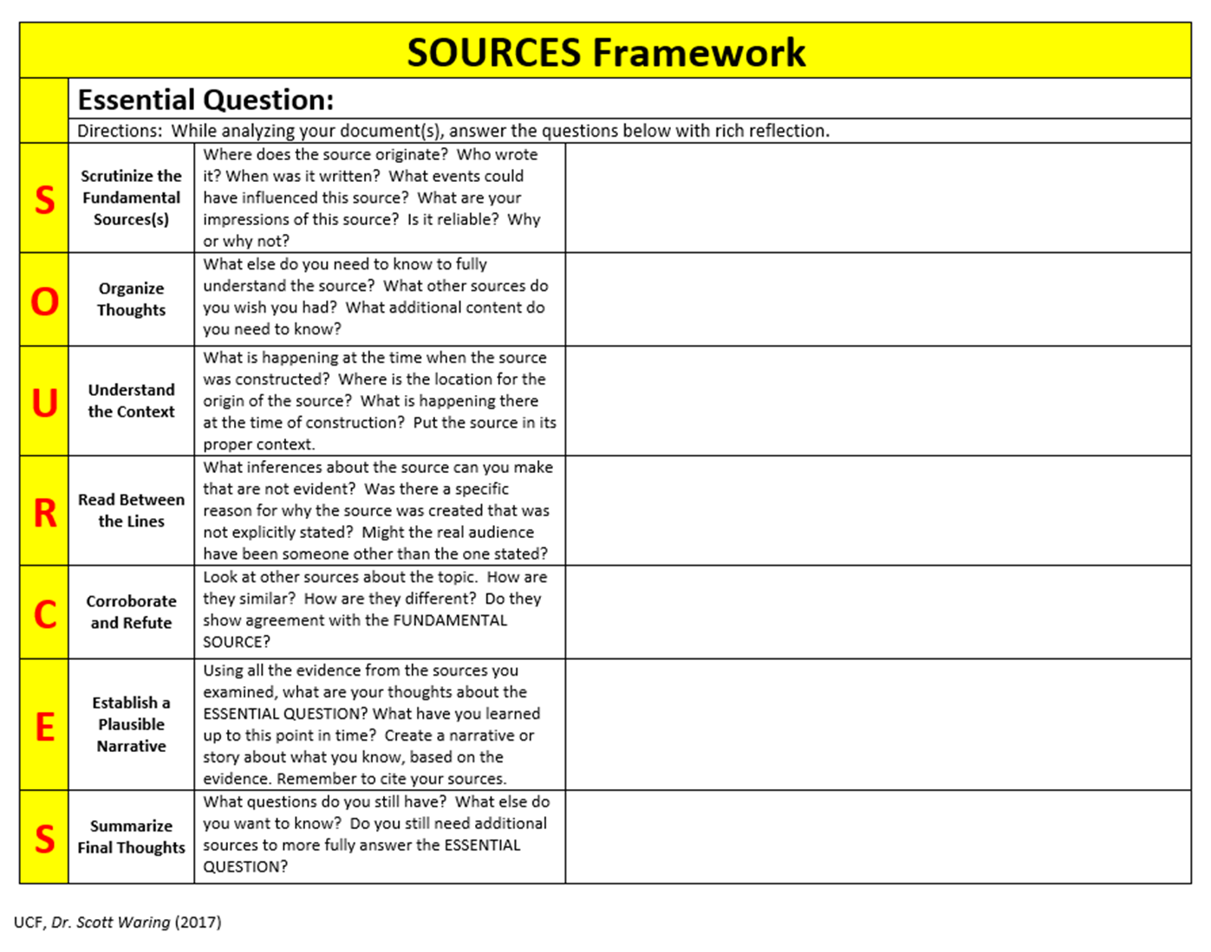

Slide 5
Civil Liberties vs Civil Rights
Civil Rights are government protection of equal treatment.
Civil Liberties ensure personal freedoms by putting limits on the governmental power.

Slide 6
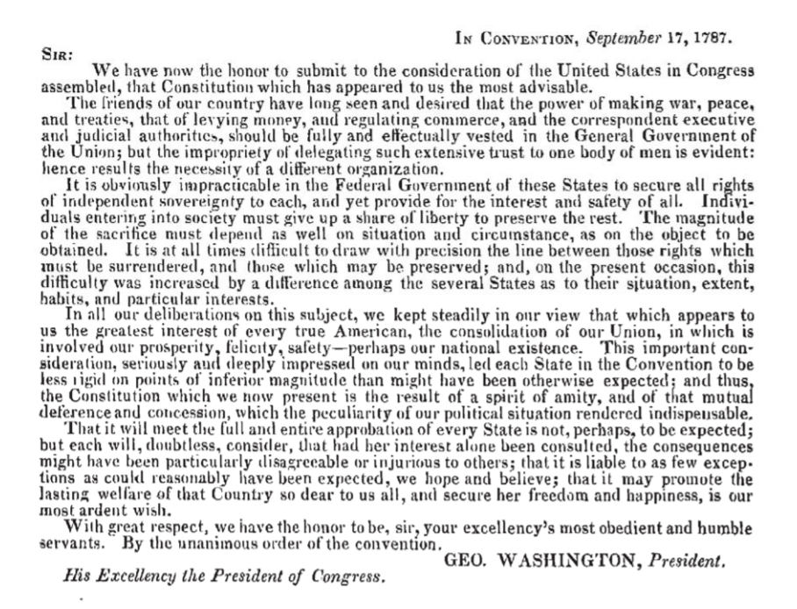
Why were civil liberties so important to the Founding Fathers?
Introduction to the Annals of Congress- George Washington Library of Congress https://memory.loc.gov/ammem/amlaw/ac001/intro3.html
Find evidence in Washington’s letter that demonstrates his beliefs on individual rights.
http://www.loc.gov/teachers/classroommaterials/primarysourcesets/constitution/pdf/washington_letter.pdf

Slide 7
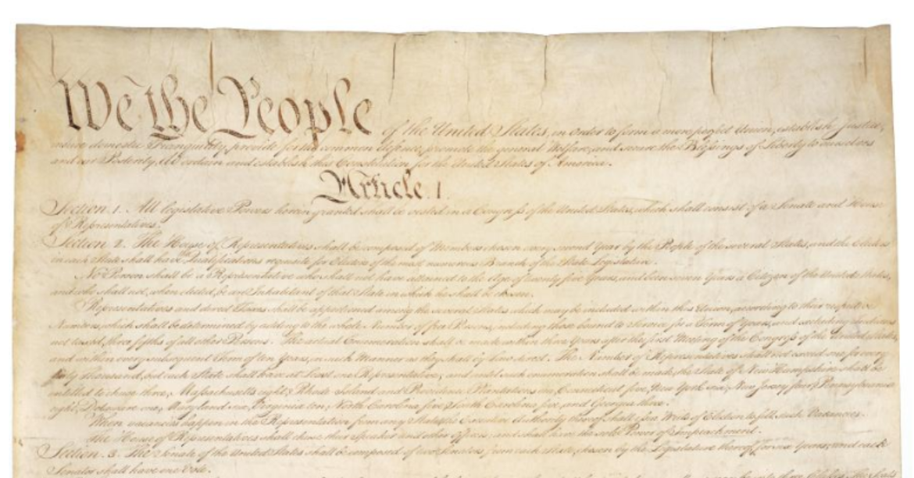
Why were civil liberties so important to the Founding Fathers?
List the ideas of individual rights found in the Preamble.
Constitution of the United States- National Archives https://catalog.archives.gov/id/1667751
We the People of the United States, in Order to form a more perfect Union, establish Justice, insure domestic Tranquility, provide for the common defence, promote the general Welfare, and secure the Blessings of Liberty to ourselves and our Posterity, do ordain and establish this Constitution for the United States of America.

Slide 8
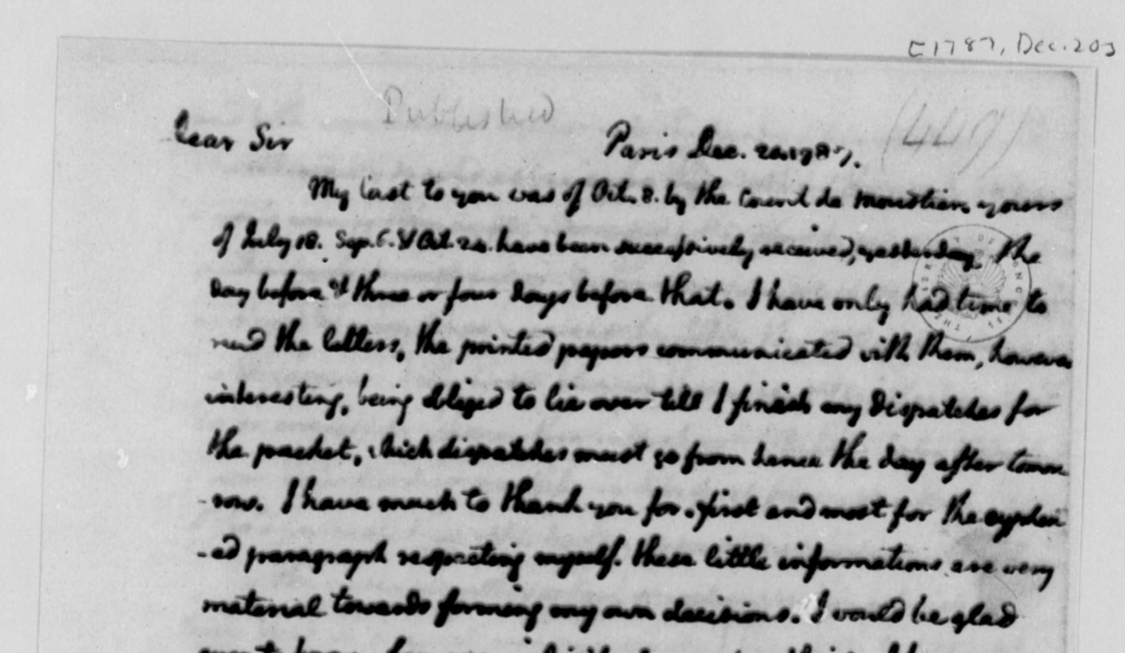
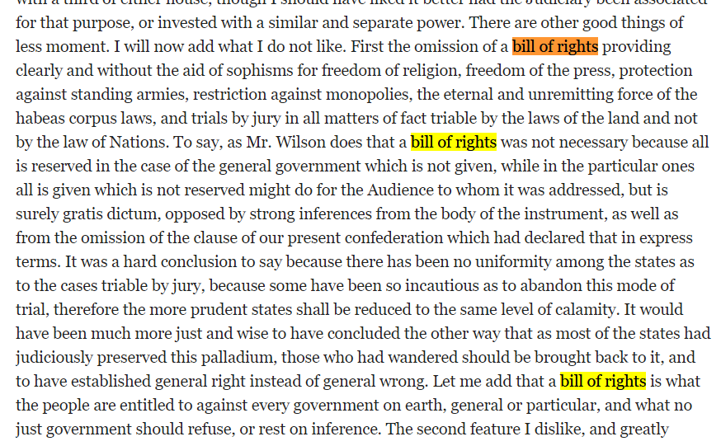
How did the Founding Fathers ensure civil liberties for the new United State?
Study Thomas Jefferson’s letter to James Madison. Rewrite the argument made by Jefferson to include a Bill of Rights in the constitution.
From Thomas Jefferson to James Madison, 20 December 1787
https://www.loc.gov/resource/mtj1.008_0727_0733/?st=gallery

Slide 9
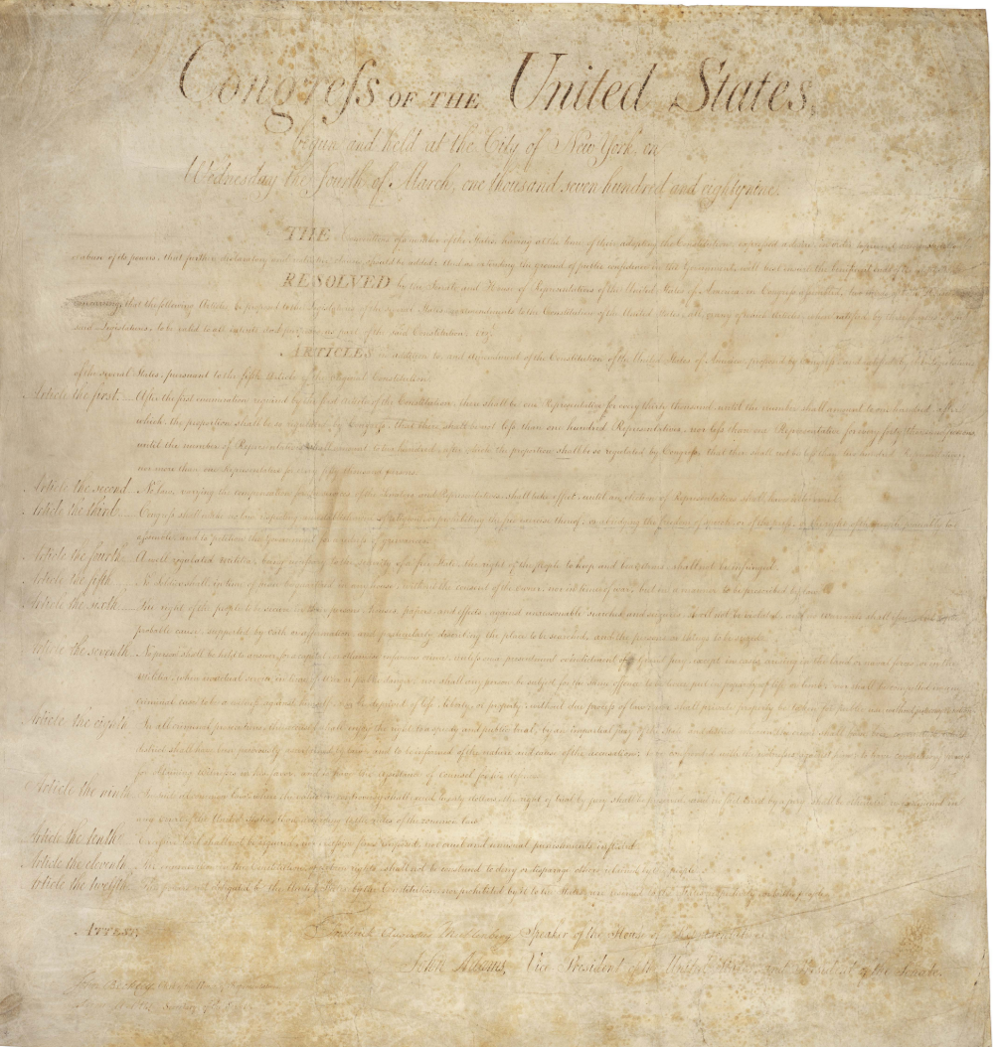
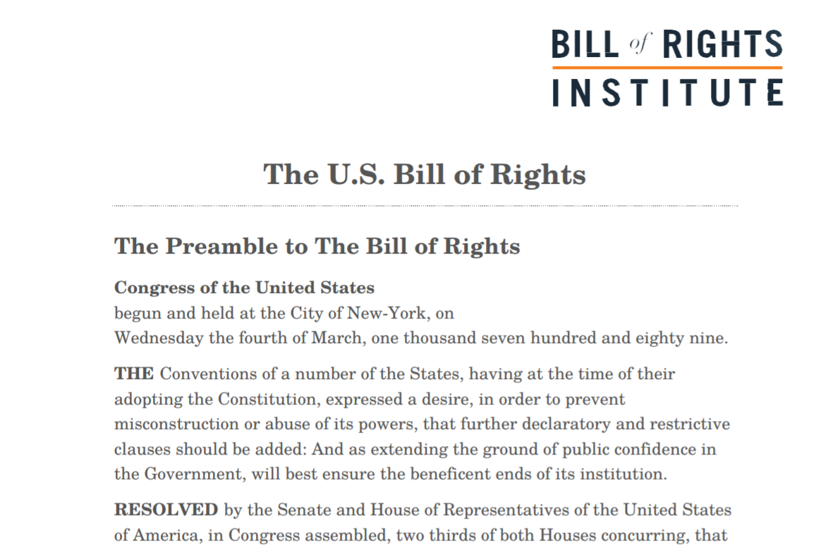
How did the Founding Fathers ensure civil liberties for the new United State?
U.S. Bill of Rights
U.S. Bill of Rights https://billofrightsinstitute.org/wp-content/uploads/2011/12/AP_Documents_BillofRights.jpg
Text Version- https://billofrightsinstitute.org/wp-content/uploads/2018/12/Bill-of-Rights-for-Website.pdf

Slide 10
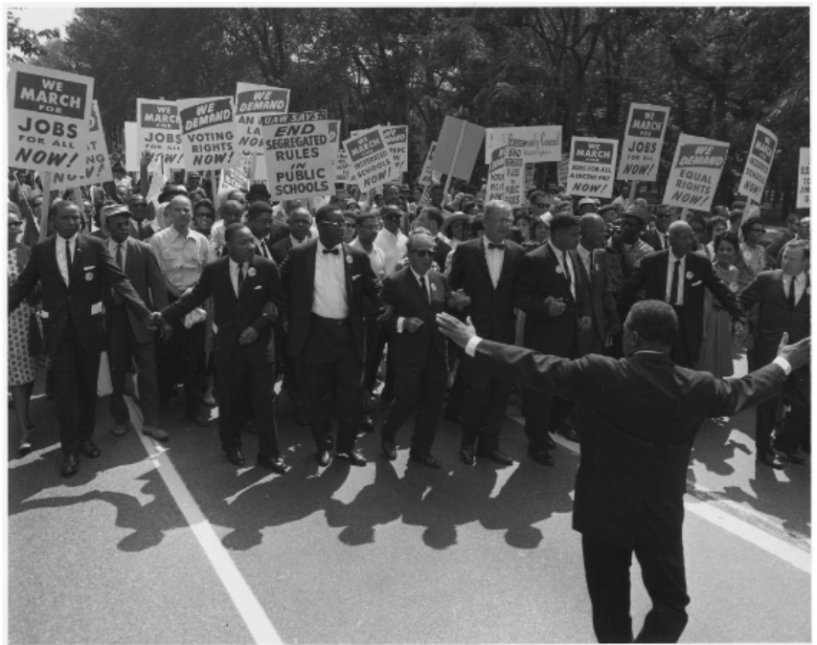
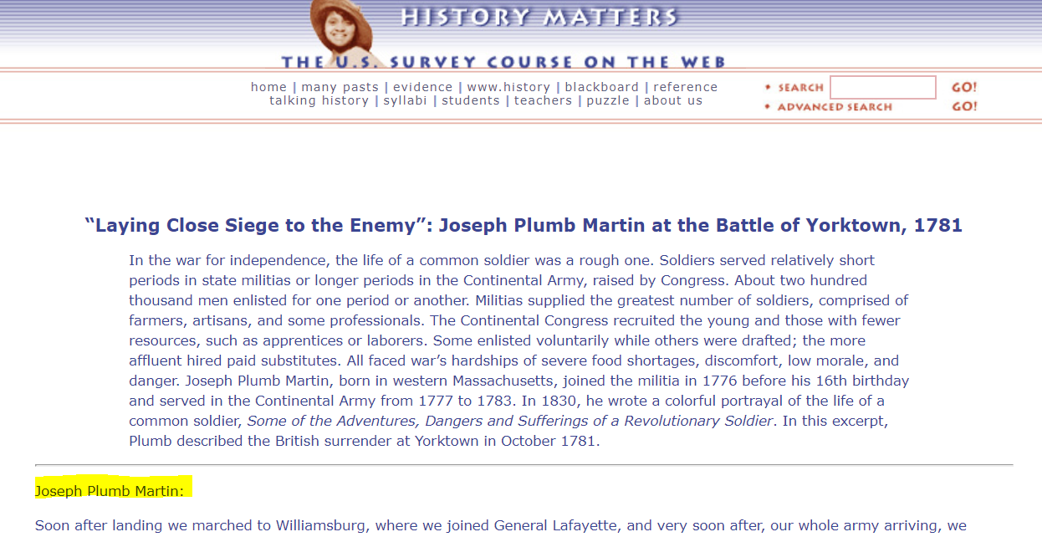
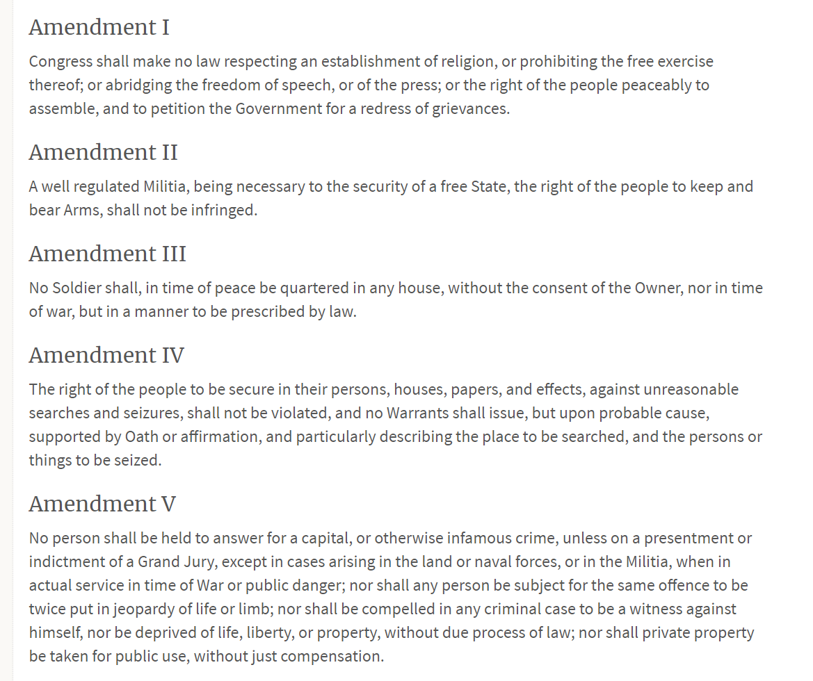
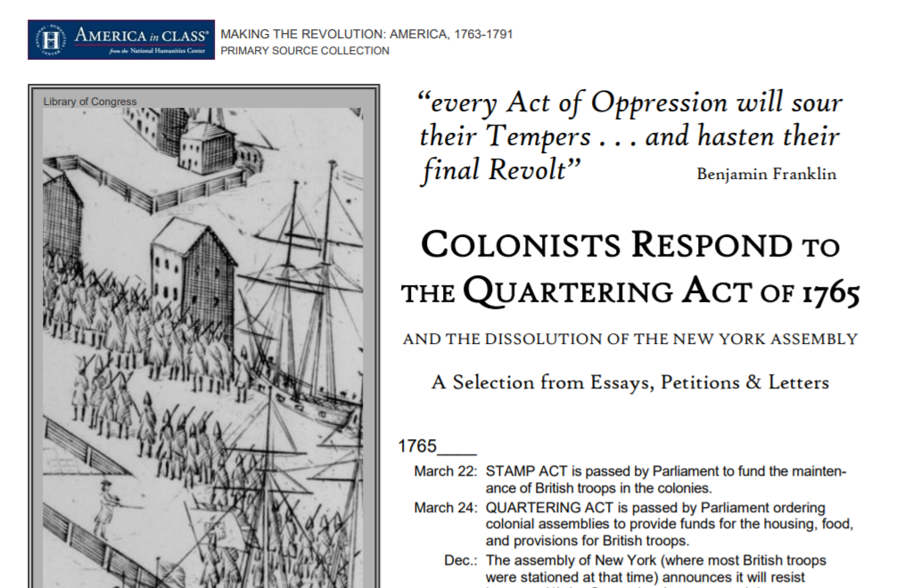
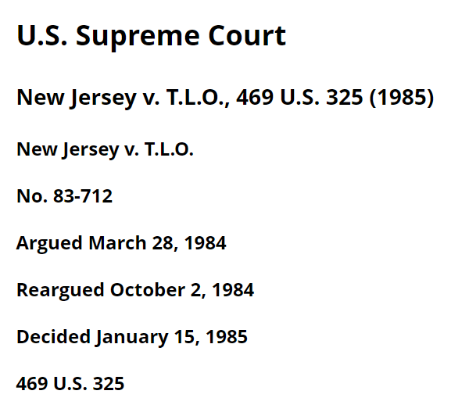
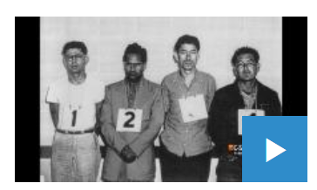
Examples of Civil Liberties

Slide 11
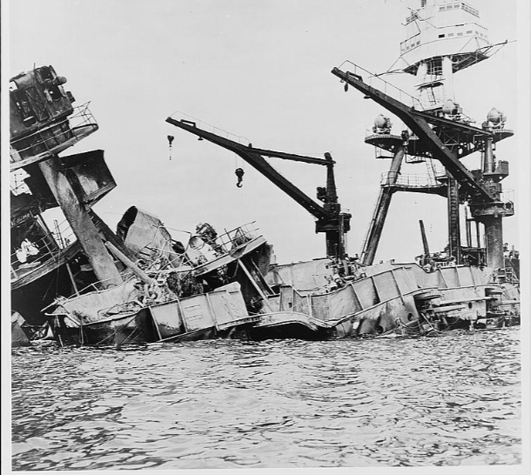
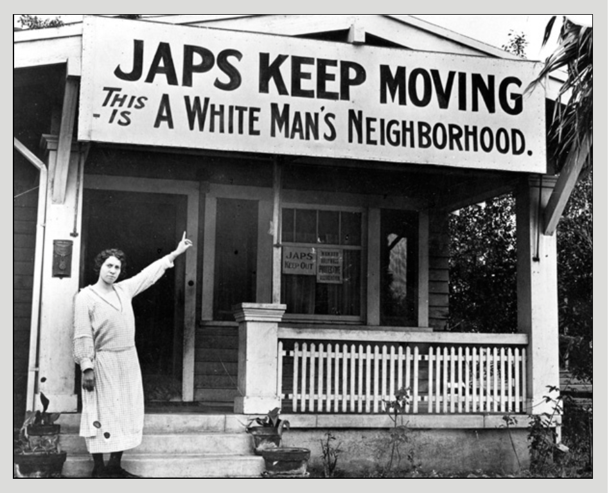
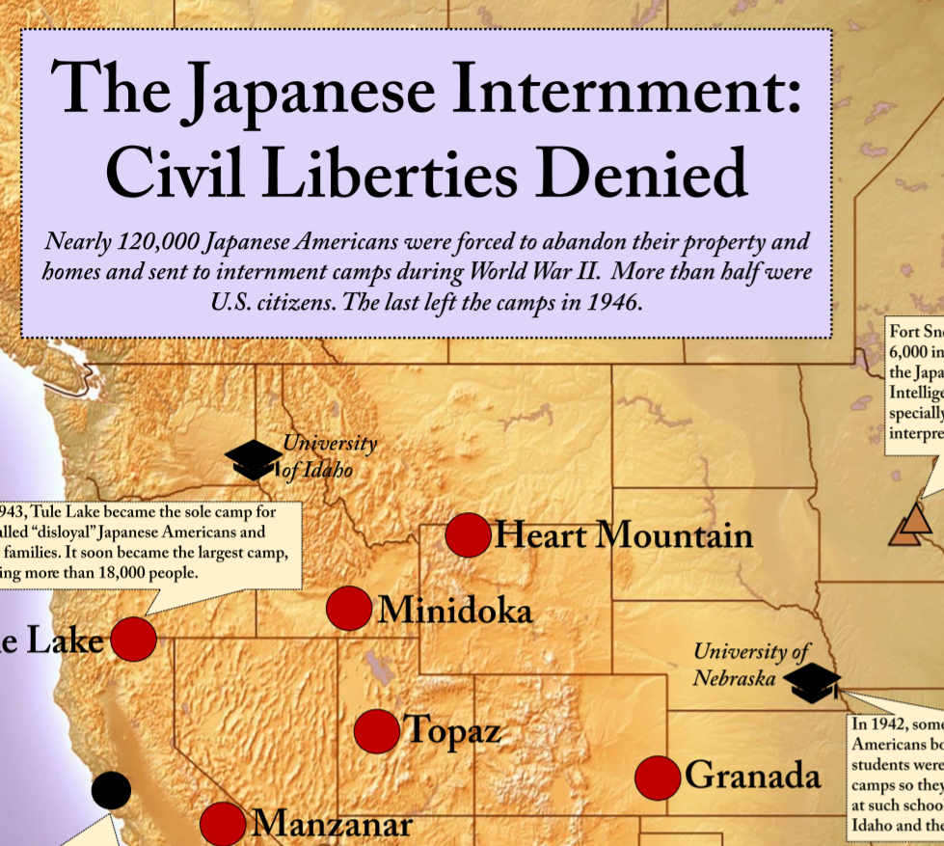
Does constitutional law promote civil liberties?
Japanese Interment

Slide 12
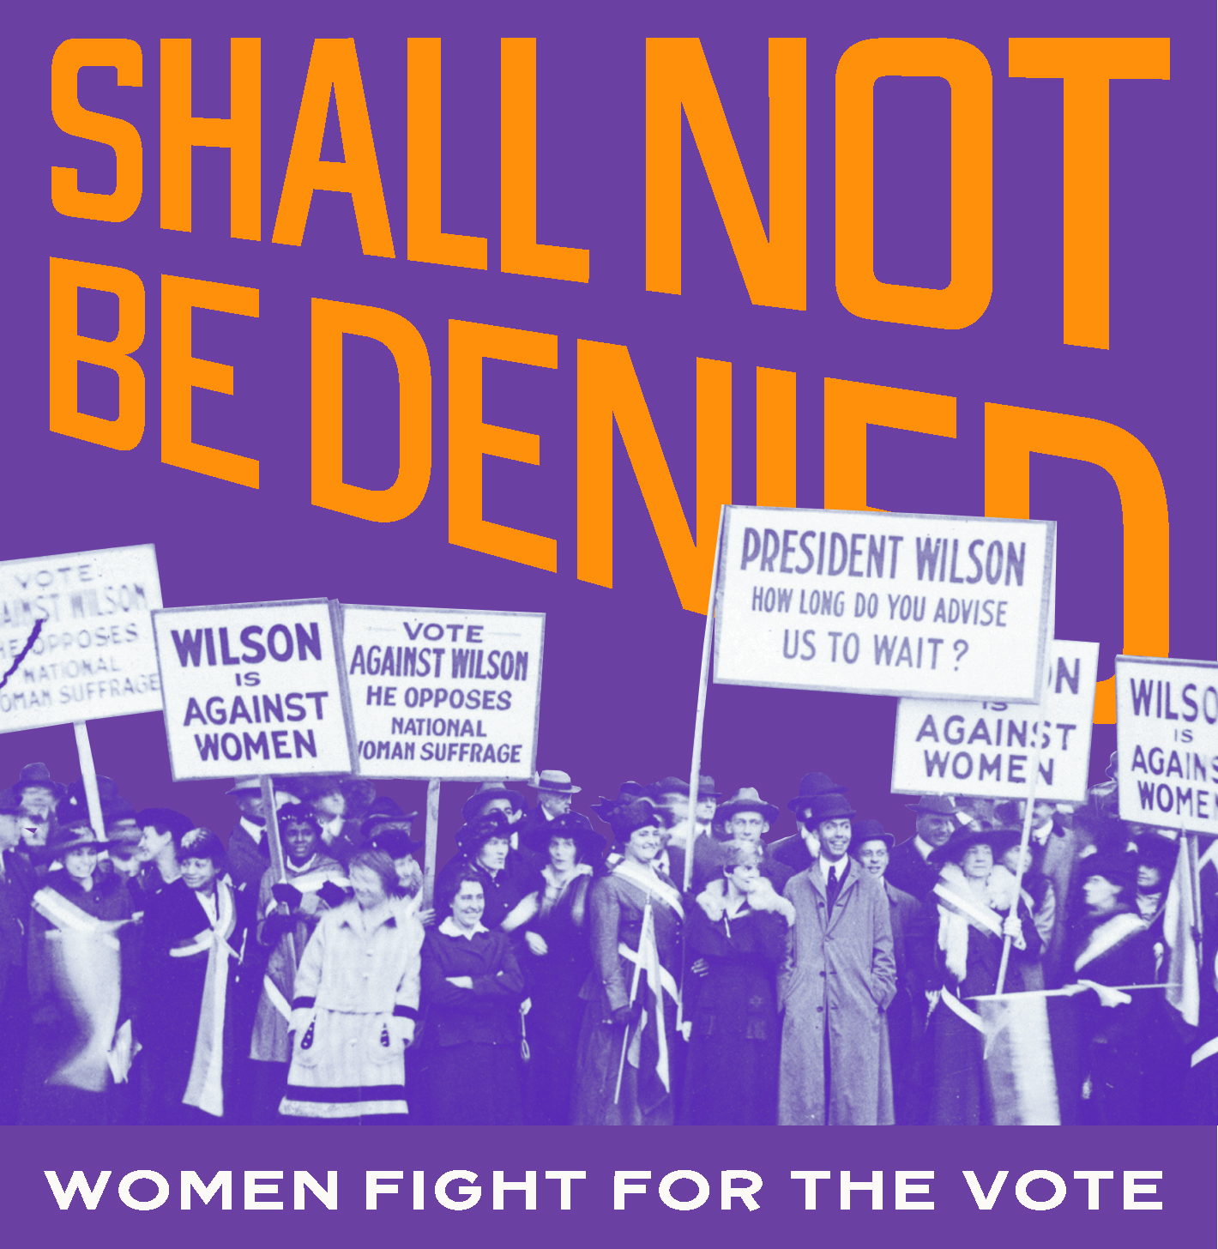
Students need to understand that civic participation is a necessity of our American democracy, men and women from the past and today have been and are continuing to encourage the legacy of civic participation.
Library of Congress Exhibitions
Shall Not Be Denied: Women Fight for the Vote June 4, 2019 – September 2020

Slide 13
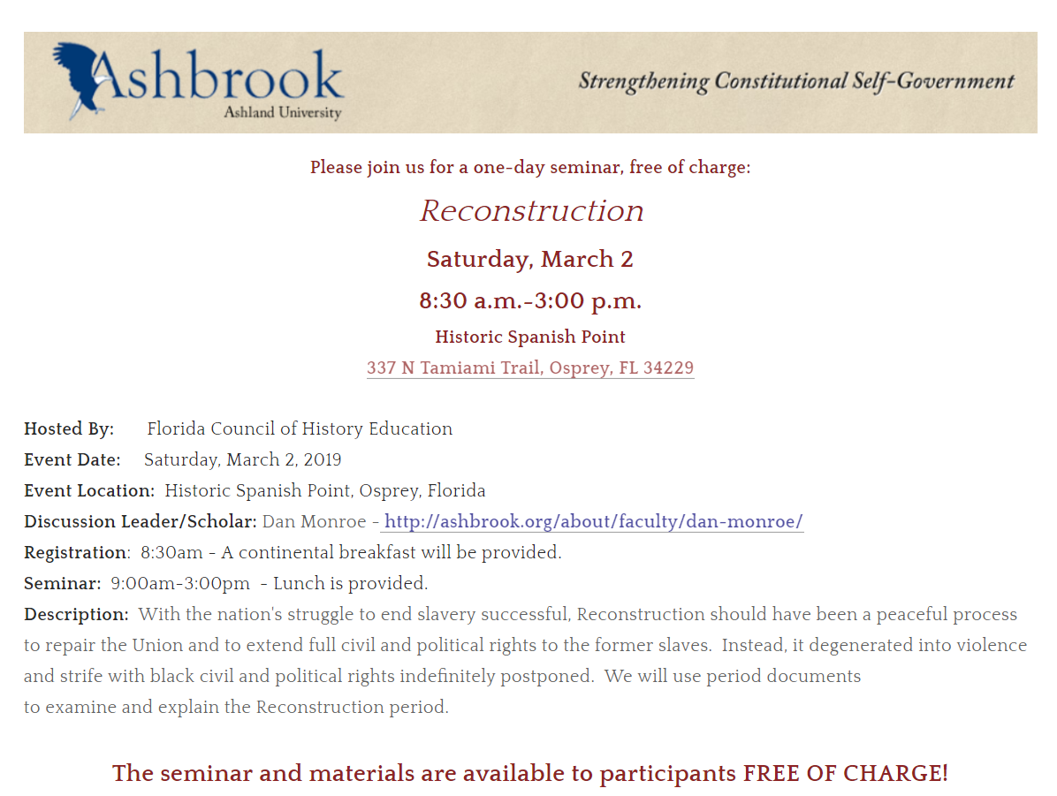
SAVE THE DATE!
Ashbrook
March 2nd
Osprey
SAVE THE DATE!
Engaging Congress
Feb. 8th
UCF

Slide 14
Florida Council for History Education’s 3rd Annual Conference St. Augustine, FL August 2-3, 2019 Lincolnville Museum Cultural Center

Slide 15
THANK YOU!
carollavallee@flche.net
tammarapurdin@flche.net

