Slide 1
Women’s Education in the Early Republic: Contextualizing Socio-Cultural Barriers
When girls are educated, their countries become stronger and more prosperous.
~Michelle Obama, 2016
Women, like men, must be educated with a view to action, or their studies cannot be called education.
~Harriet Martineau, 1831
S.O.U.R.C.E.S Conference
January 2020
Kacie M. Nadeau, Ph.D
kacienadeau@gmail.com

Slide 2
Inspiration
Historiographical essay in 2012, Women’s Higher Education in the Early Republic.
Thesis:
Historical examination of American society in the late eighteenth century generates compelling discourse on how the expansion of educational opportunities for women reflected shifting paradigms in both public and private social realities.
Guiding Question:
How have historians traditionally captured this era and under what circumstances does the expansion of women’s higher education transpire?

Slide 3
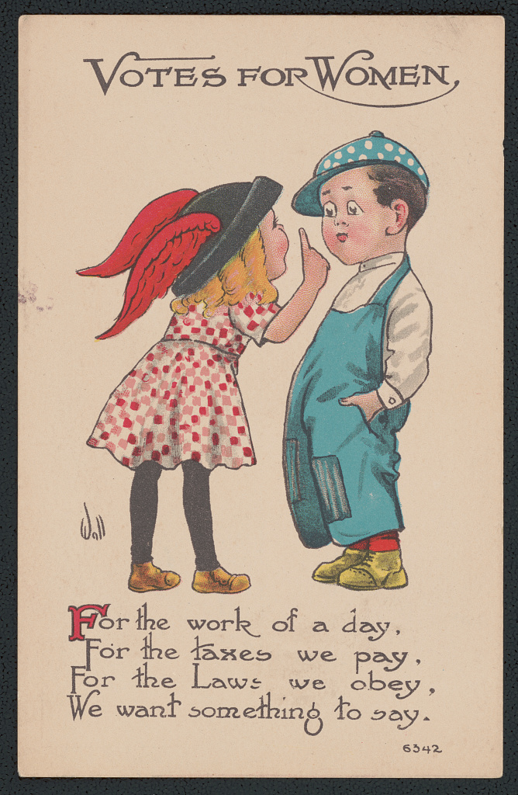
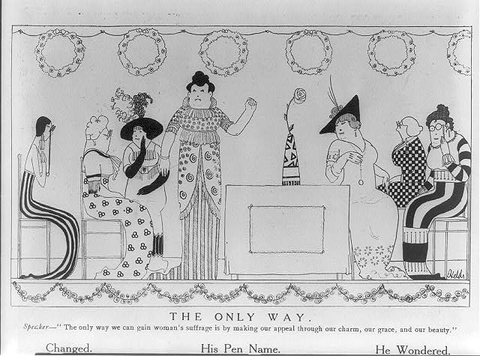
November 9, 1912 https://cdn.loc.gov/service/pnp/cph/3a30000/3a34000/3a34700/3a34796r.jpg
1913 https://www.loc.gov/resource/ds.13244/

Slide 4
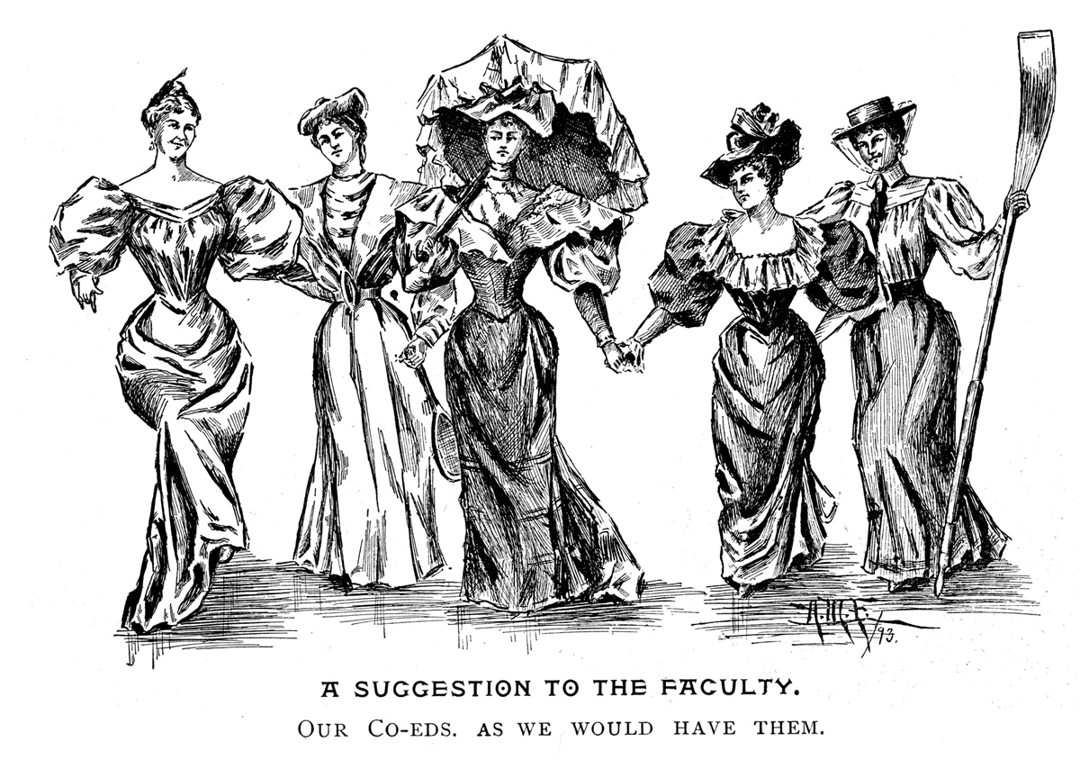
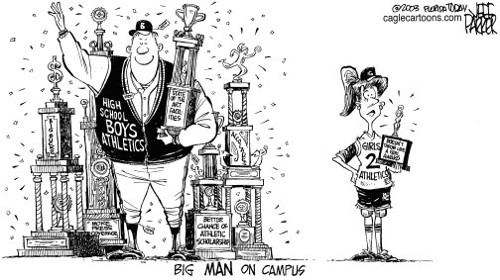
https://www.tolerance.org/classroom-resources/tolerance-lessons/editorial-cartoons-gender-discrimination
The Yale Record 1893
The Yale Record 1893 https://yalealumnimagazine.com/articles/3518-the-pioneers?page=1

Slide 5
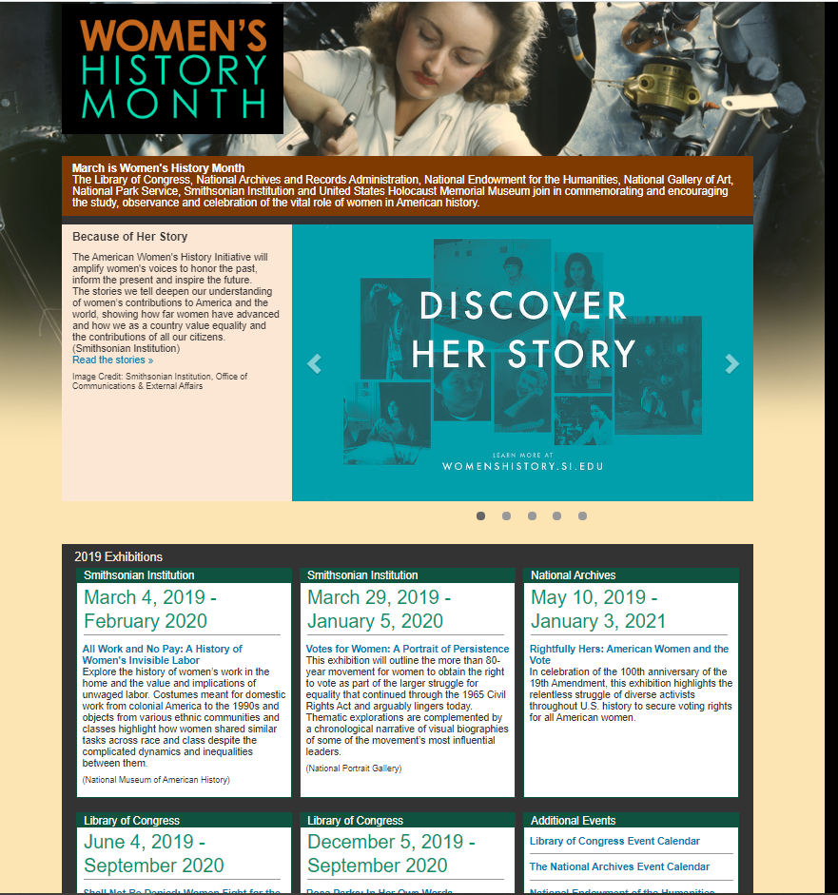
Women’s History: Timelines
19th Amendment, 1920
Timeline (1/20/2017)
Top Moments in Women’s History (12/26/2018)
Top Moments
http://www.womenshistorymonth.gov/
Title IX,
1972
Seneca Falls Convention, 1848

Slide 6
Women’s Right to Vote (10/5/10)
Right to Vote
Historical Thinking Skills:
Sourcing
Contextualization
Corroboration
Close Reading
Such skills MUST be used with both primary and secondary sources.

Slide 7
Traditional thoughts on women and higher education?
Where?
When?
Curriculum?
How much of this is mentioned in your standards?
Your textbook?
Does it matter?

Slide 8
Thoughts on female education… What social spheres/barriers are reflected?
“No employment of the mind is a sufficient excuse for neglecting domestic duties, and I cannot conceive that they are incompatible. A woman may fit herself to be the companion and friend of a man of sense, and yet know how to take care of his family.”
Mary Wollstonecraft, Thoughts on the Education of Daughters With Reflections on Female Conduct, in the More Important Duties of Life, 1787
“It is a remarkable fact, and full of significance, that the women who have that peculiar organization, (in some, it is education, and not organization,) which inclines them to break over the barriers of sex, have always aimed their efforts at those prominent points in which a man’s superiority, at that particular time, was most conspicuous and attractive;-proving that it was the special eminence which man then occupied which moved their ambition, rather than any conviction of the equality or identity of their widely differing natures.”
Horace Mann, A few thoughts on the powers and duties of woman two lectures, 1853
“ If the improvement of the American female character, and that alone, could be effected by public liberality, employed in giving better means of instruction, such improvement of one half of society, and that half, which barbarous and despotic nations have ever degraded, would of itself be an object, worthy of the most liberal government on earth; but if the female character be raised, it must inevitably raise that of the other sex: and thus does the plan proposed, offer, as the object of legislative bounty, to elevate the whole character of the community.”
Emma Willard. An Address to the Public Particularly to the Members of the Legislature of New York Proposing a Plan for Improving Female Education. Middlebury: J.W. Copeland, 1819
“…that our daughters may be qualified to fill with dignity, propriety and usefulness, the important stations, which they may be called to occupy. But prayer, without corresponding exertion, is presumption. We are not to expect miracles. Something must be done, in order that females may attaining that dignified and elevated rank in society, for which the God of nature, as the Bible, has manifestly designed them.
Joseph Emerson, Female Education, a Discourse, Delivered at the Dedication of the Seminary Hall in Saugus, Jan. 15, 1822, to which is added the Little Reckoner, Consisting Principally of Arithmatical Questions for Infant Minds

Slide 9
Social Spheres: Public vs. Private
What role did/does gender play?
Was education an equalizing (or an attempt) factor?
(as early as the 18th century?)
Male/ female?
Paid employment
Government and politics
Male/ female?
Domestics
Home
Children
Education
Such spheres are fluid and permeable, constantly shifting by social norms

Slide 10
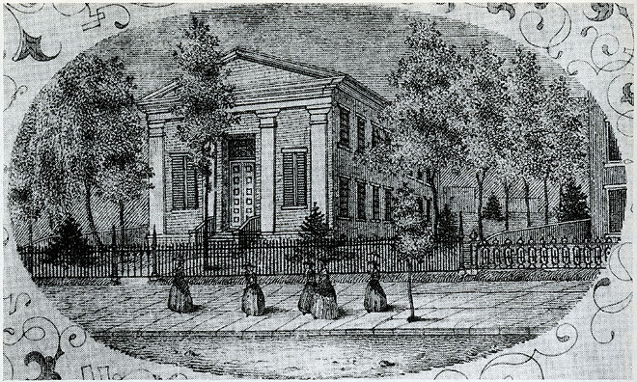
Early Higher Education for Women
Clinton Female Seminary (later Georgia Female College/now Wesleyan) (1821)
Troy Female Seminary (1821), New York*
Hartford Female Seminary (1823)*
Columbia Female Academy (today Stephens College) (1833)
Wheaton Female Seminary in Norton, Massachusetts (1834)
Mount Holyoke Female Seminary (1837)*
Oberlin (admitted women in 1837)
Seven Sisters (Barnard, Radcliffe, Pembroke…companion to Ivy League) (1837-1889)
*Typically most referenced institutions

Slide 11
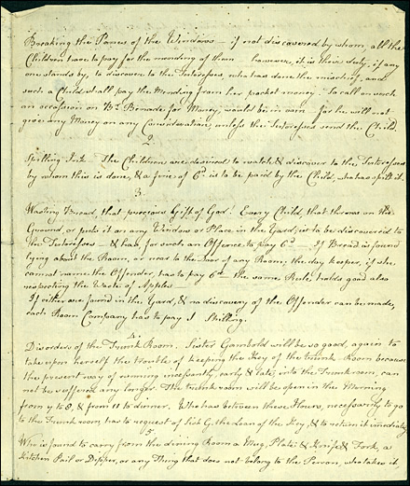
18th Century Higher Education for Women?
Moravian Female Seminary in Germantown/Bethlehem, Pennsylvania (1742)
Salem College in North Carolina (later Salem Female Academy) (1772)
Young Ladies’ Academy in Philadelphia,
Pennsylvania (1787)
First chartered female academy in the U.S. by 1792

Slide 12
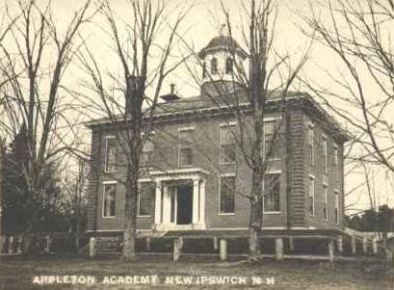
College vs. Academy
“Defining exactly what was meant by the term institute, academy, seminary, and college is a difficult, perhaps impossible task. There were no clear definitions at the time; indeed, higher education was ‘a flexible nineteenth century concept’” (Nash, 2005).
Colleges: 3-4 years, degree earning, mostly male
Academies: beyond traditional degrees offered at colleges (more specialized)
Colleges and academies interchangeable (male)
Academies and seminaries interchangeable (female)
As a result, the historiography of female education is complicated through this language.
How many schools/opportunities for institutionalized education have been ignored in the historiography as a result of terminology?

Slide 13
Historians’ Perspectives: Influencing Factors
Women’s (all!) history is often defined by the social context in which the historian is influenced.
We need to better contextualize these perspectives by viewing their analysis at the time in which they were produced
This presentation includes three historical perspectives (1957, 1980, 2005)

Slide 14
Historians’ Analyses: Secondary Sources
Savin, M.B. & Abrahams, H.J. (1957) The Young Ladies’ Academy of Philadelphia. History of Education Journal, 8(2), 58-67. (p. 59-61)
Kerber, L. (1980) Women of the Republic: Intellect and Ideology in Revolutionary America. Chapel Hill: University of North Carolina. (p. 31-35)
Nash, M.A. (2005). Women’s education in the United States 1780-1840. New York: Palgrave MacMillan. (p. 35-36).
What are the social-cultural barriers? Are these gendered? What role did/could education play in shaping norms?
How can primary sources shape this history (as compared to women’s history portrayed in standards/textbooks/narratives?)
How can contextualizing secondary sources on higher education for females assist in the narrative?

Slide 15
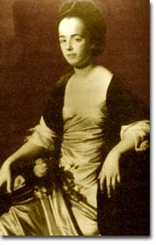
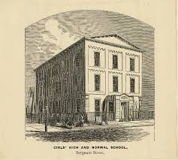
Using Primary Sources
Mrs. Harriet Gould Drake Tinkam, Recollections of a Moravian Boarding School, 1817
Bethlehem Boarding School for Girls Student “Cyphering Book” 1790
Abigail Adams to John Thaxter, 15 February 1778
Thomas Jefferson to Nathaniel Burwell, 14 March 1818
Benjamin Rush, Thoughts Upon Female Education, 1787
Judith Sargent Murray, On the Equality of the Sexes, 1790
Selected quotes on females education (Obama, Martineau,
Mann, Emerson, Wollstonecraft, Willard)

Slide 16
A series of maps to Willard's History of the United States, or, Republic of America. Designed for schools and private libraries.
Emma Willard, 1828 http://hdl.loc.gov/loc.gmd/g3701sm.gct00033
America’s first female mapmaker

Slide 17
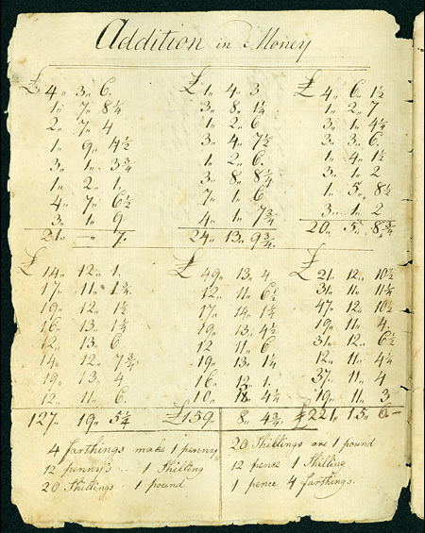
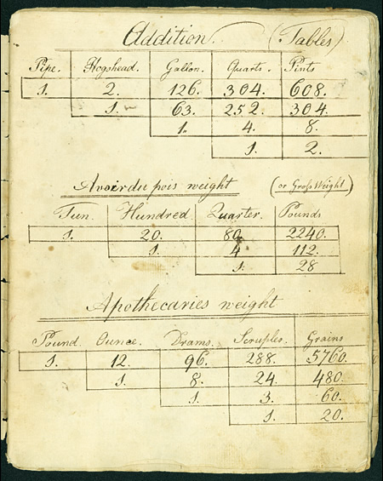
What do these sources suggest about higher education?
What might be the socio-cultural contexts present in society? How do you know?

Slide 18
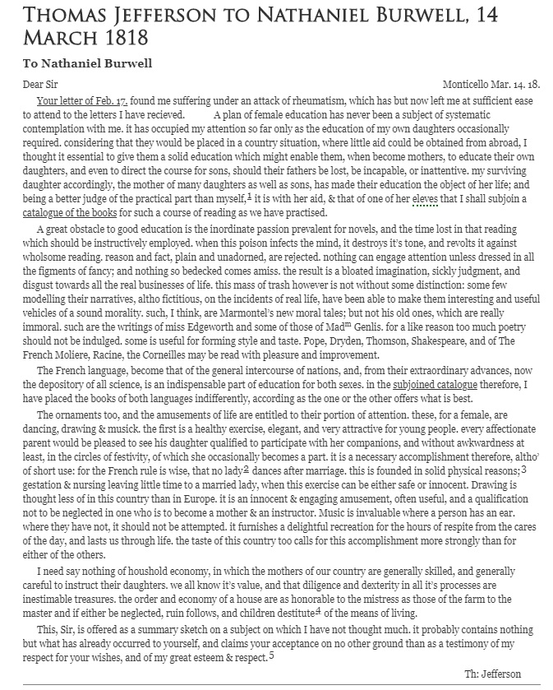
How are Adams and Jefferson’s letter similar? What differs? What may account for the differences?
Do either of these sources support/negate the prior primary sources?
Does anything surprise you?

Slide 19
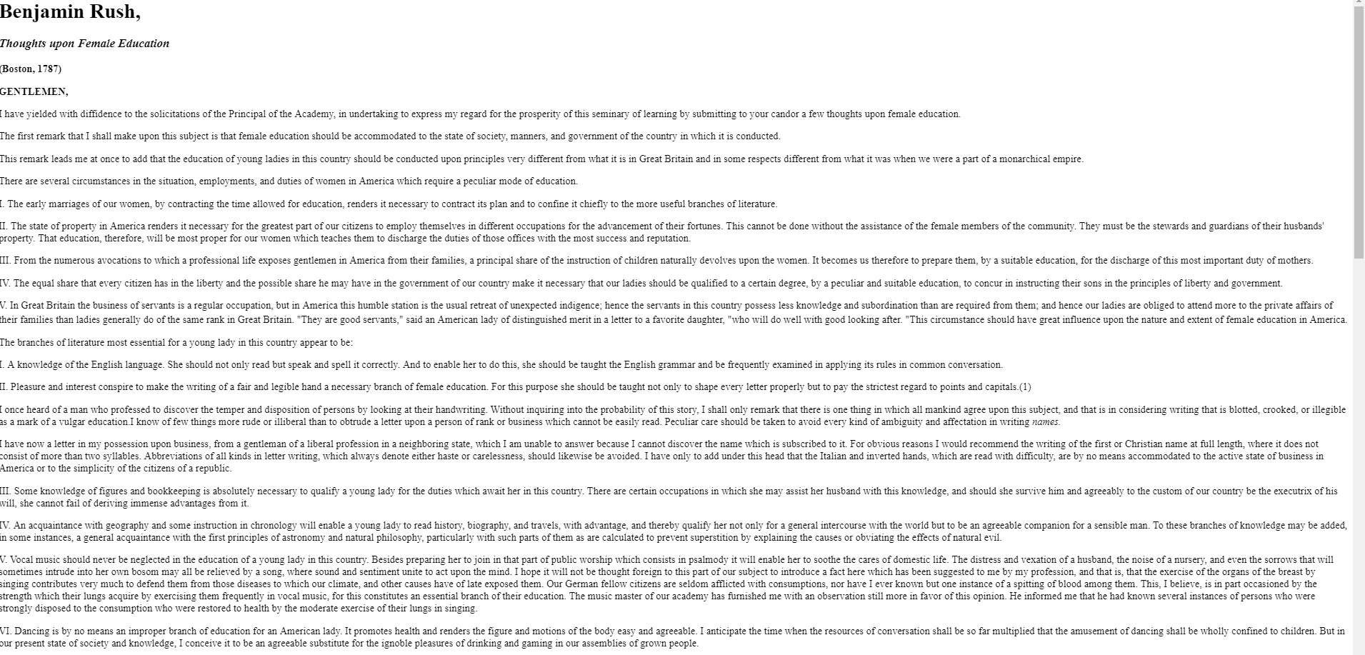
What are the perceptions of female intellect/capability?
What are the suggestions for female education?
What are the influencing factors? What evidence can you use?
What more would you like to know?

Slide 20
Lasting Thoughts…
What is the traditional narrative of gender roles for women?
How may 18th century thoughts on the institutionalized education challenge such ideologies?
Should the traditional narratives of women’s rights include data from a post-Revolutionary America? Why?
Did institutions such as the Young Ladies Academy expand or solidify the roles of women? How can the education of women be used to understand the role of education in contemporary terms?
How can the historical context demonstrate existing social-cultural barriers and how can the expansion of educational opportunities for women reflect shifting paradigms in both public and private social realities in a new nation?

Slide 21
References
“Abigail Adams to John Thaxter, 15 February 1778,” Founders Online, National Archives, accessed April 11, 2019, https://founders.archives.gov/documents/Adams/04-02-02-0312 . [Original source: The Adams Papers, Adams Family Correspondence, vol. 2, June 1776 – March 1778, ed. L. H. Butterfield. Cambridge, MA: Harvard University Press, 1963, pp. 390–393.]
Bethlehem Boarding School for Girls Student “Cyphering Book” (1790). http://bdhp.moravian.edu/education/femsemdocs/cypherbk/cypherbk01.htm
Thomas Jefferson to Nathaniel Burwell, 14 March 1818,” Founders Online, National Archives, accessed April 11, 2019, https://founders.archives.gov/documents/Jefferson/03-12-02-0438-0001. [Original source: The Papers of Thomas Jefferson, Retirement Series, vol. 12, 1 September 1817 to 21 April 1818, ed. J. Jefferson Looney. Princeton: Princeton University Press, 2014, pp. 532–533.]
Kerber, L. (1980) Women of the Republic: Intellect and Ideology in Revolutionary America. Chapel Hill: University of North Carolina.
Murray, J.S. (1790). On the Equality of the Sexes. Originally published in The Massachusetts Magazine, or, Monthly Museum of Knowledge and Rational Entertainment. http://nationalhumanitiescenter.org/pds/livingrev/equality/text5/sargent.pd
Nash, M.A. (2005). Women’s education in the United States 1780-1840. New York: Palgrave MacMillan.
Rush, Benjamin. (1787). Thoughts upon Female Education. http://www.swarthmore.edu/SocSci/rbannis1/AIH19th/female.html
Savin, M.B. & Abrahams, H.J. (1957) The Young Ladies’ Academy of Philadelphia. History of Education Journal, 8(2), 58-67.
Tinkam, H. (1817). Recollections of Mrs. Harriet Gould Drake Tinkam: student, 1817. http://bdhp.moravian.edu/education/tinkam/tinkam_04.htm

